Slide 1

MSUAS OPEN ACCESS 2024
E-Resources
Our complete how-to on accessing our e-resources at Manicaland State University of Applied Sciences

Slide 2
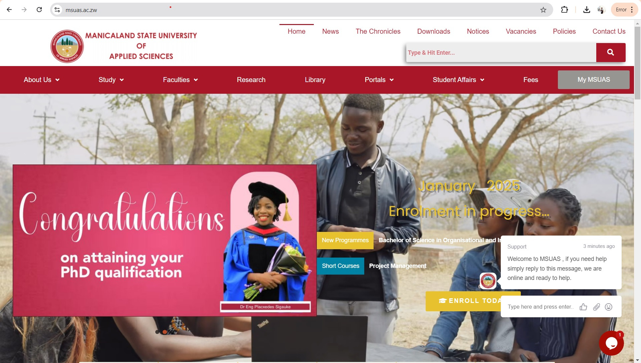

Step 1: Visit the Msuas website

Slide 3
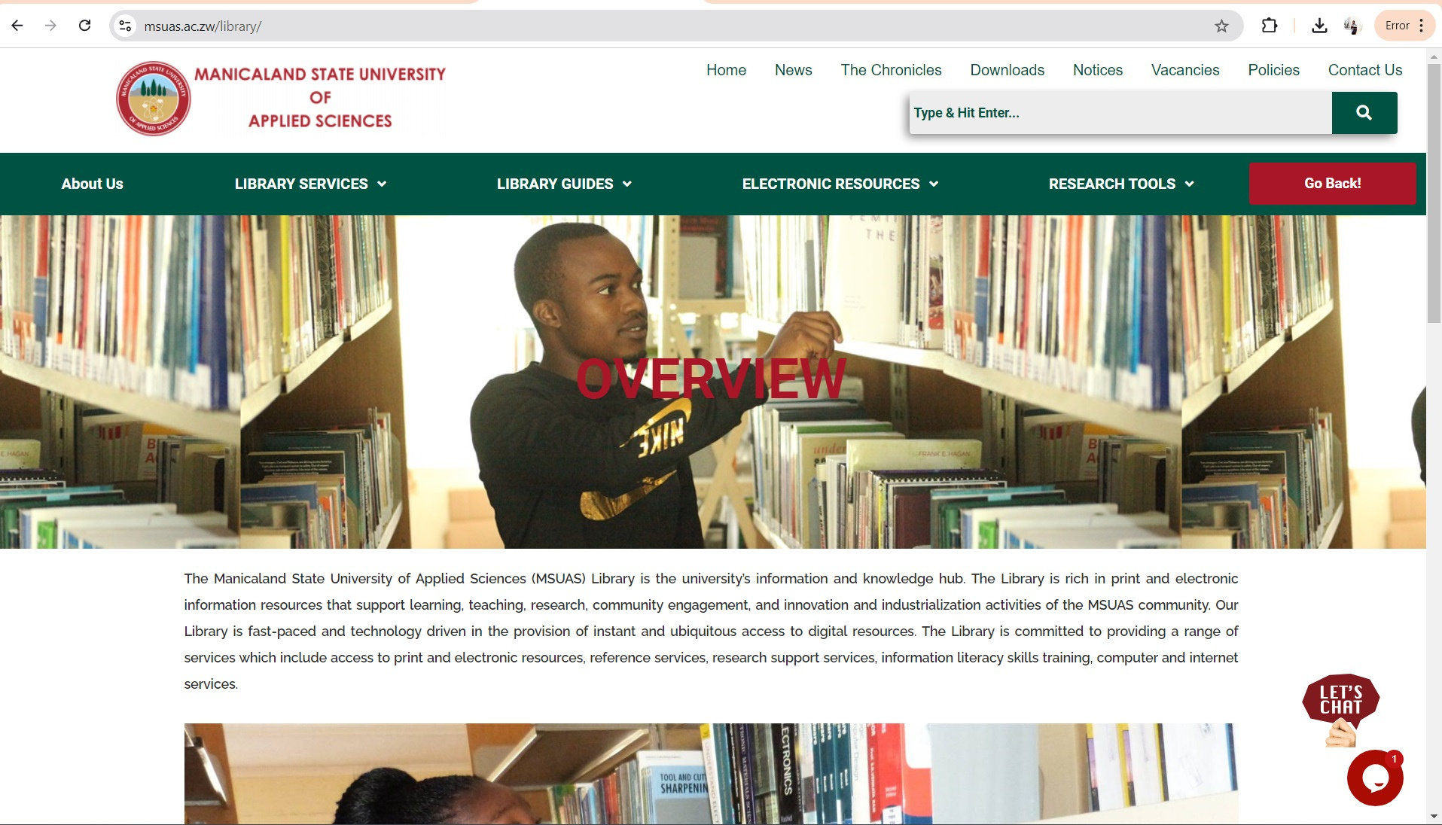
Step 2: go to the library page

Slide 4
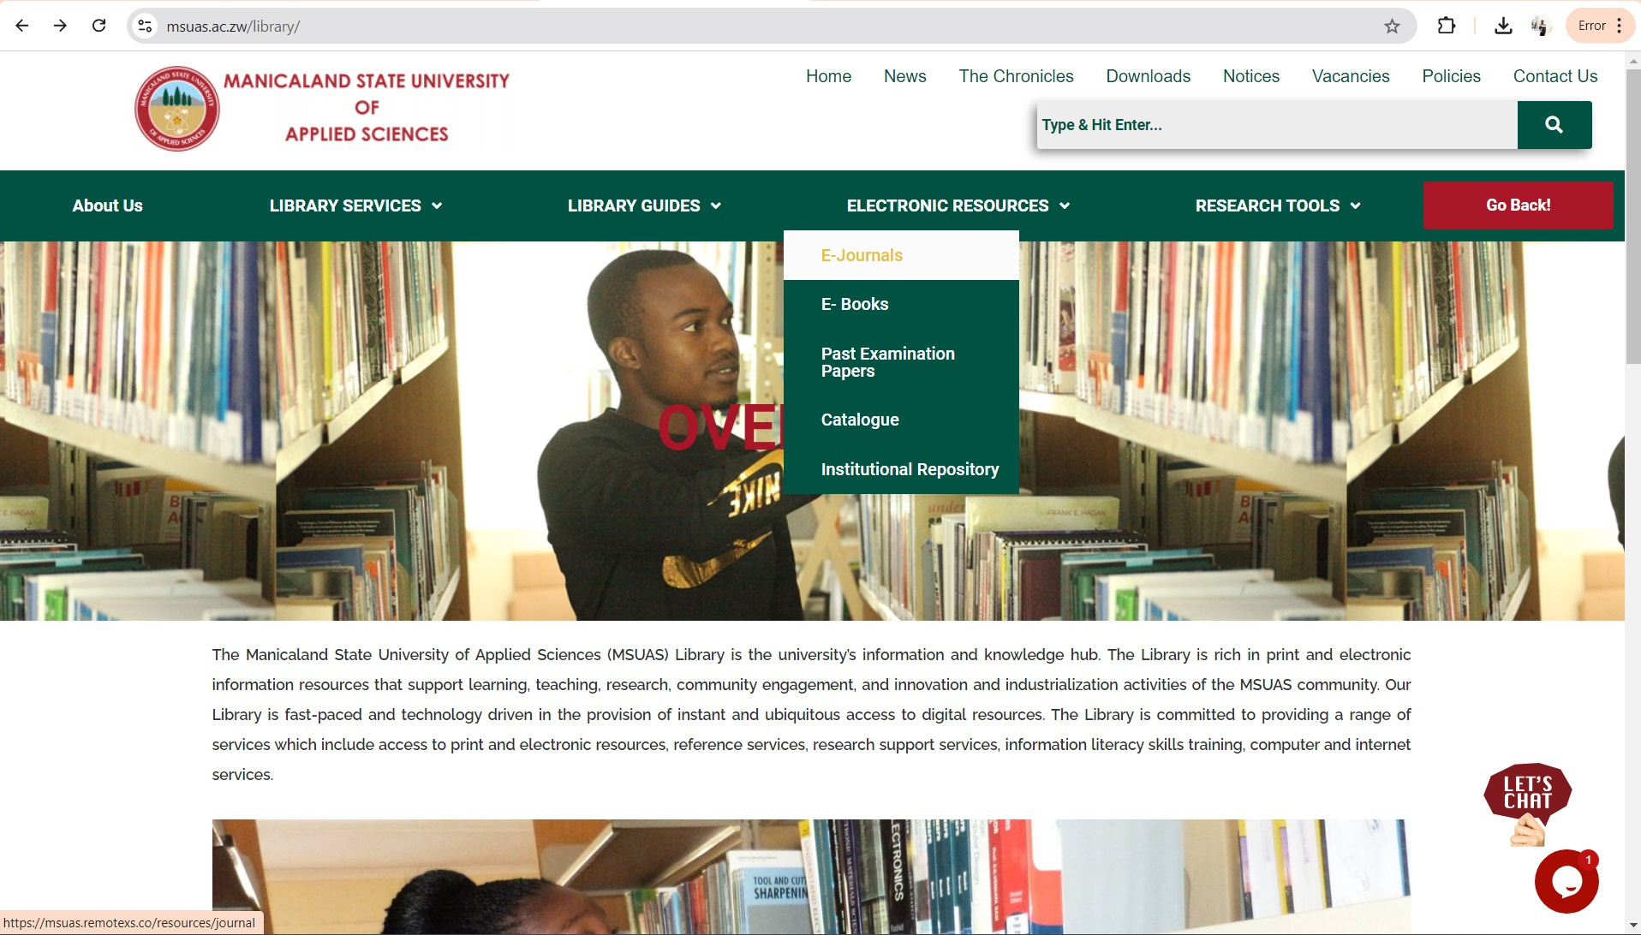
Step 3: Choose the resource you want to access

Slide 5
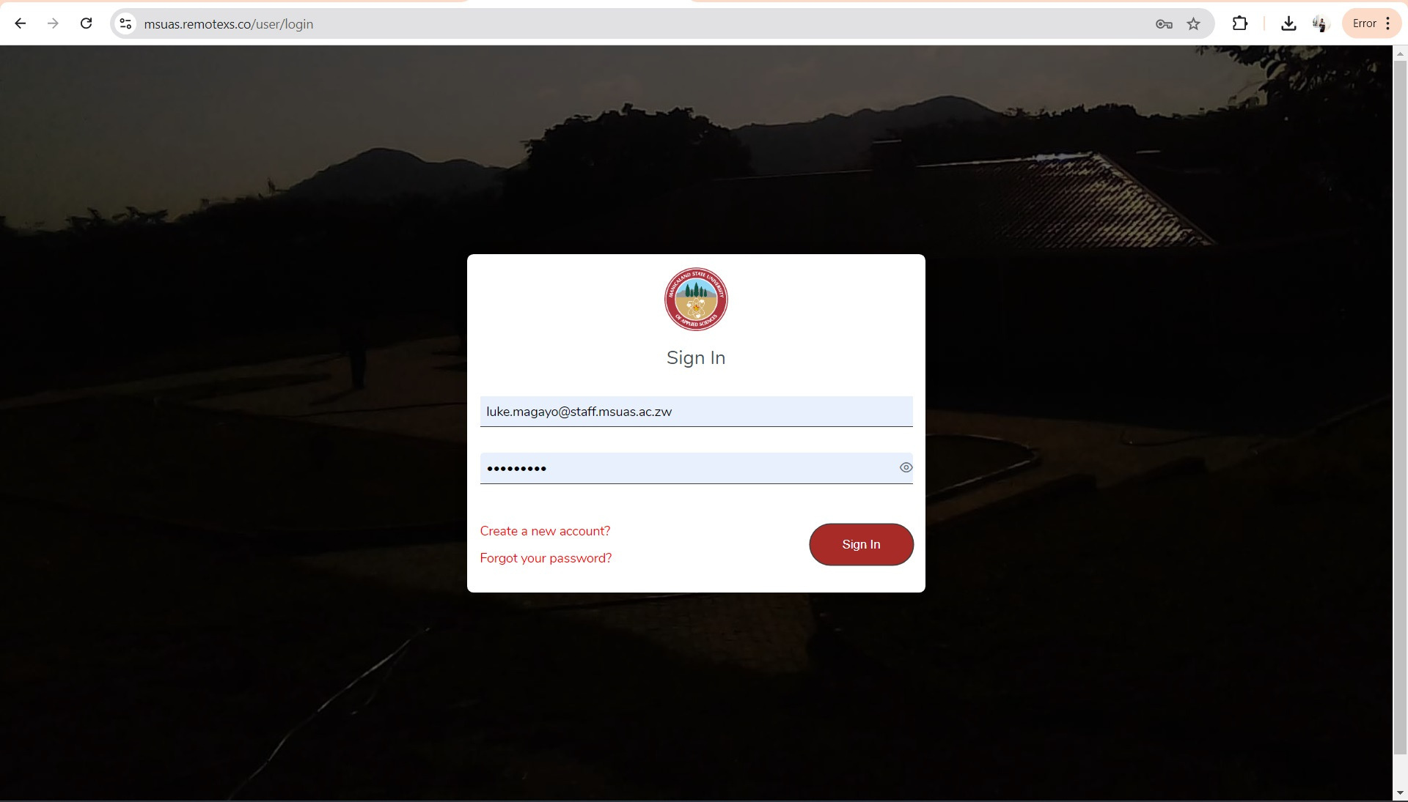
Step 5: Login to remotexs or create a new account

Slide 6
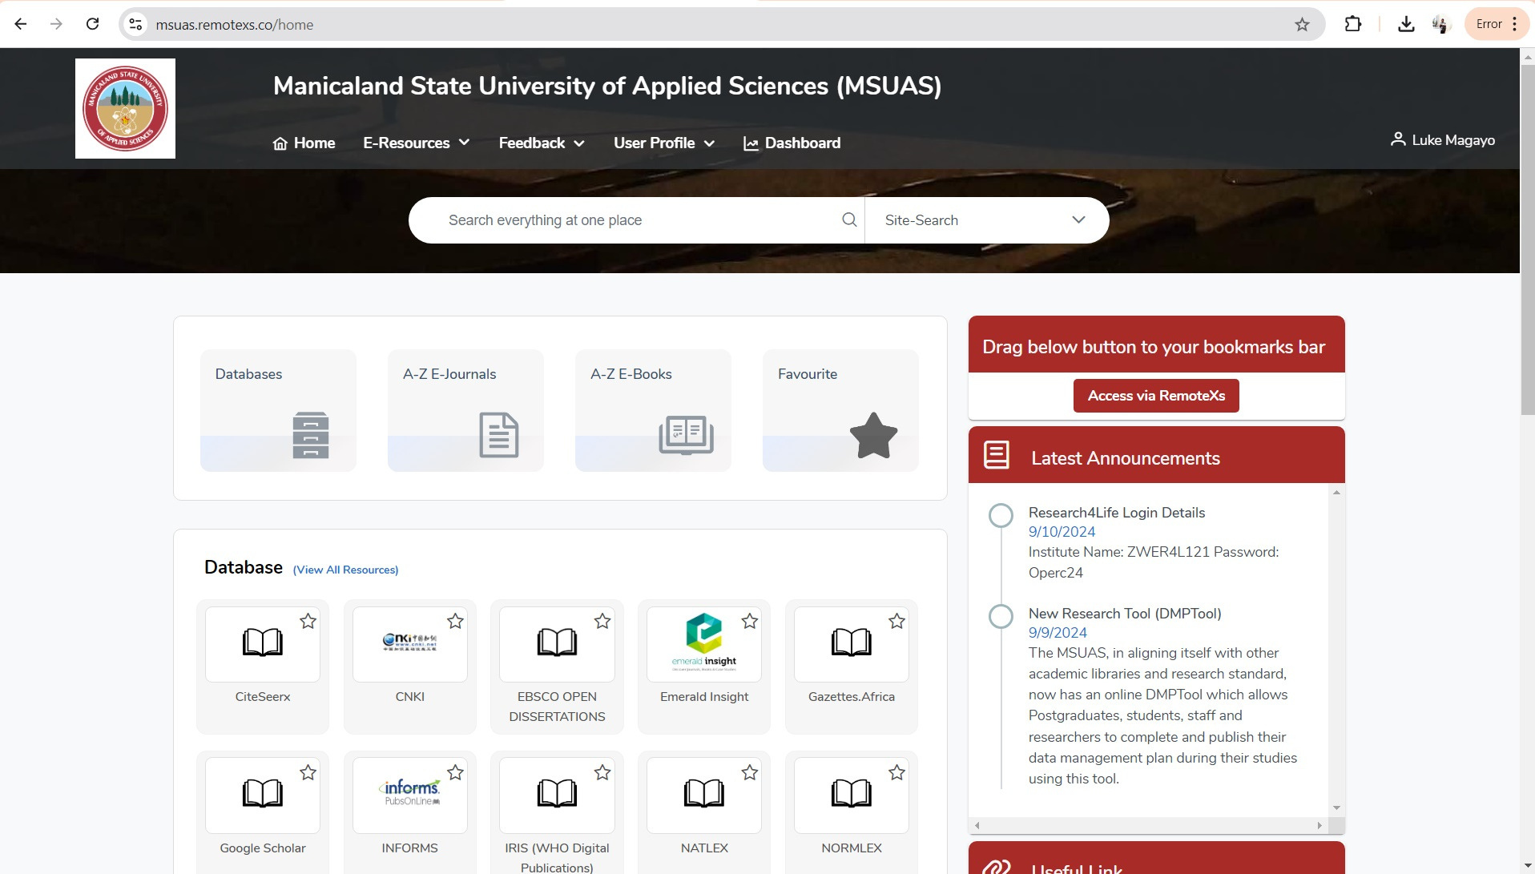
Step 6: Select a database to access

Slide 7
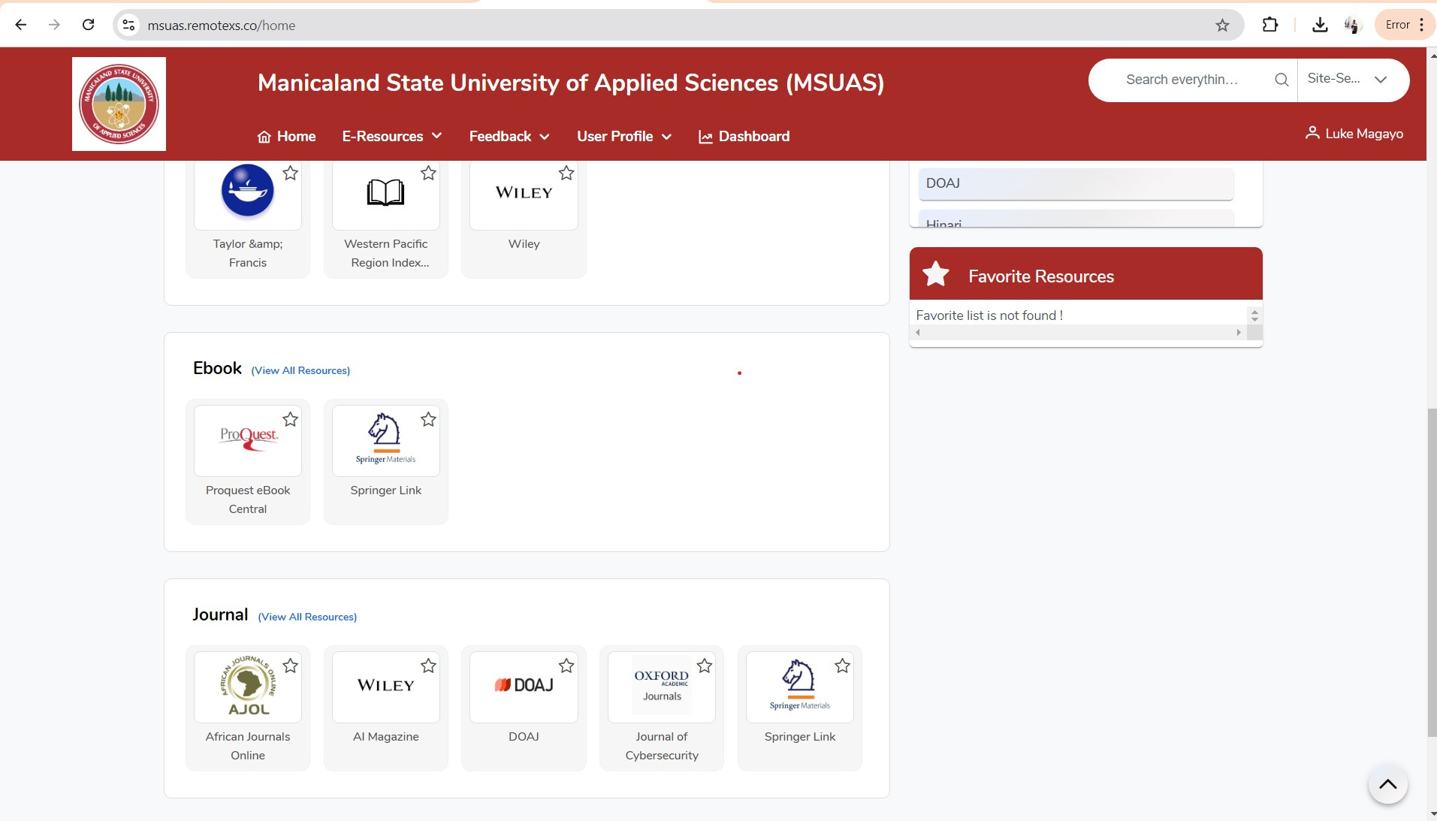
Step 6: Select a database to access

Slide 8
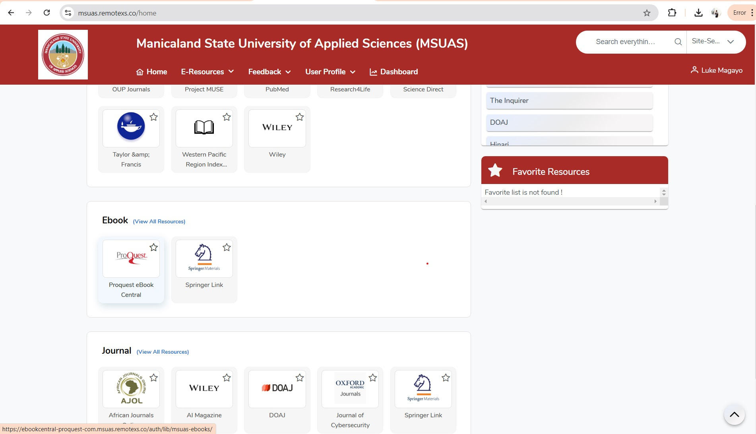
Step 6: Select a database to access

Slide 9
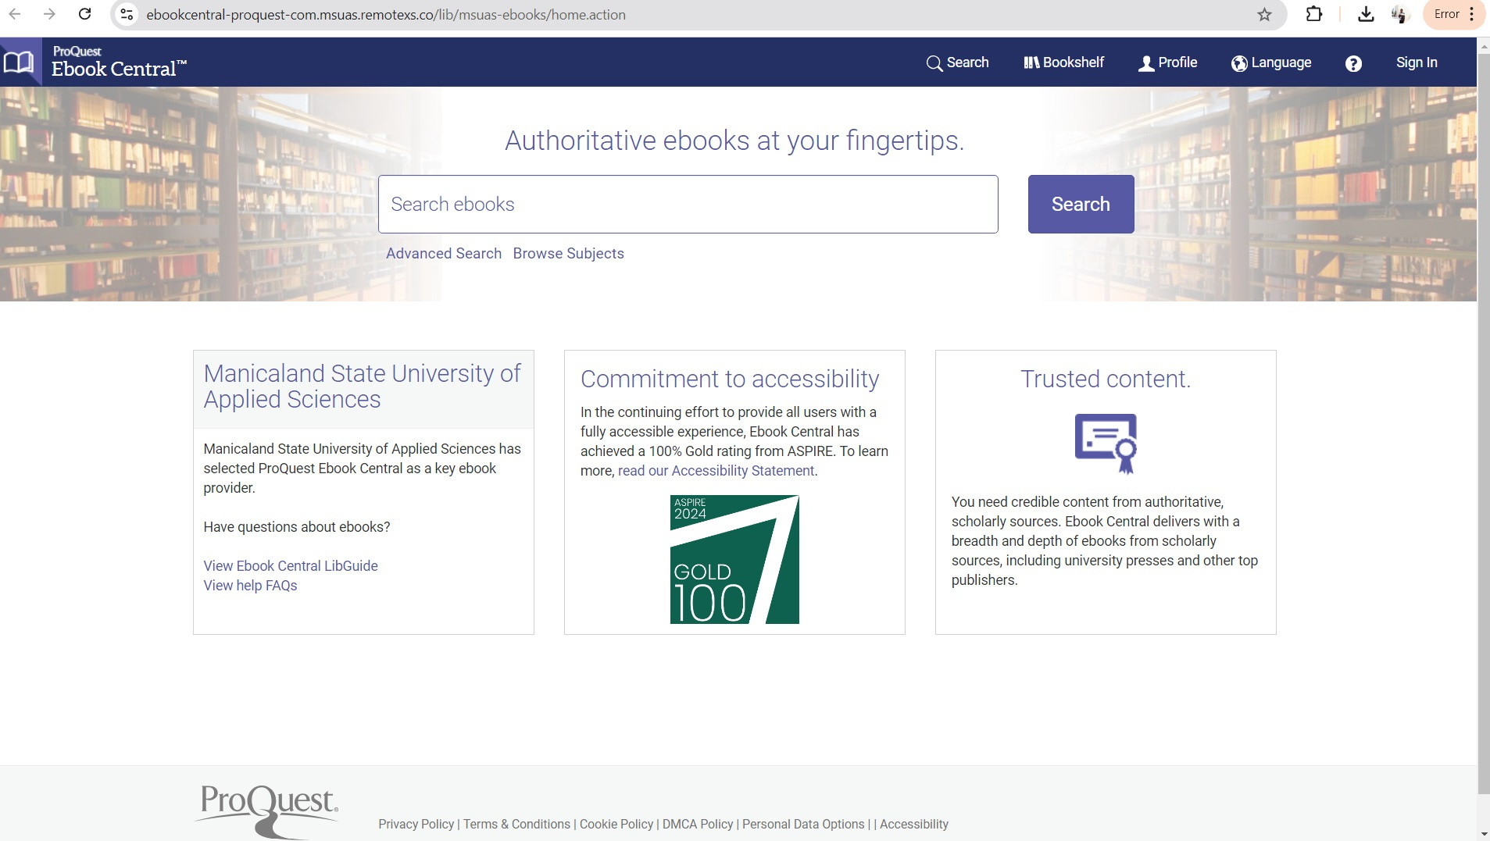
Step 7: Using Proquest e-book central

Slide 10
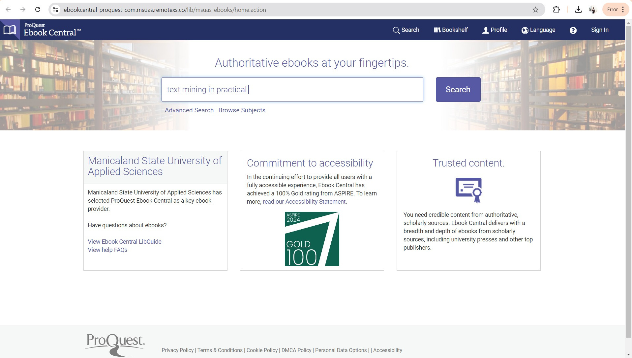
Step 8: search for books using keywords or titles

Slide 11
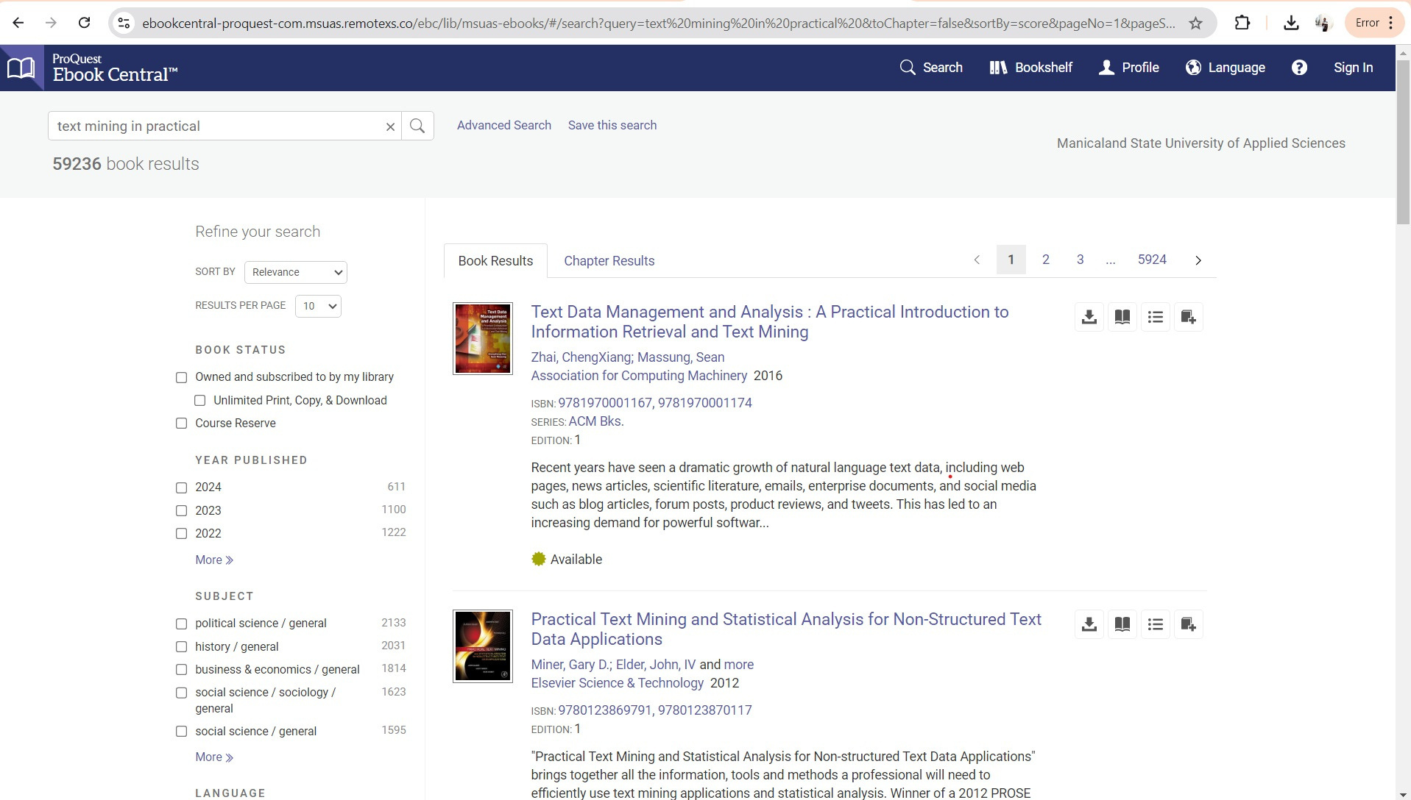
Step 9: Filter to suit your search needs

Slide 12
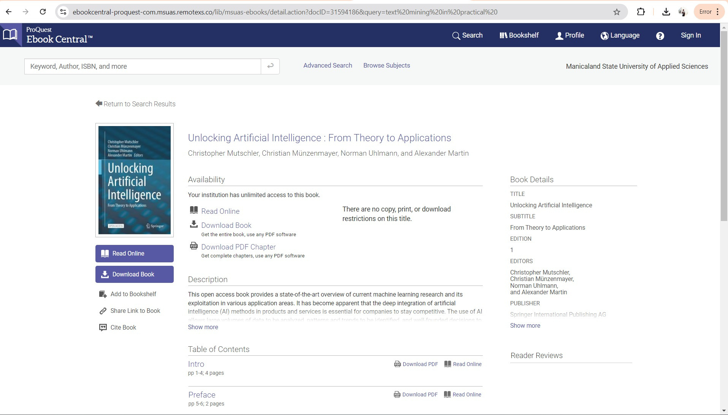
Step 10: select book & click download

Slide 13
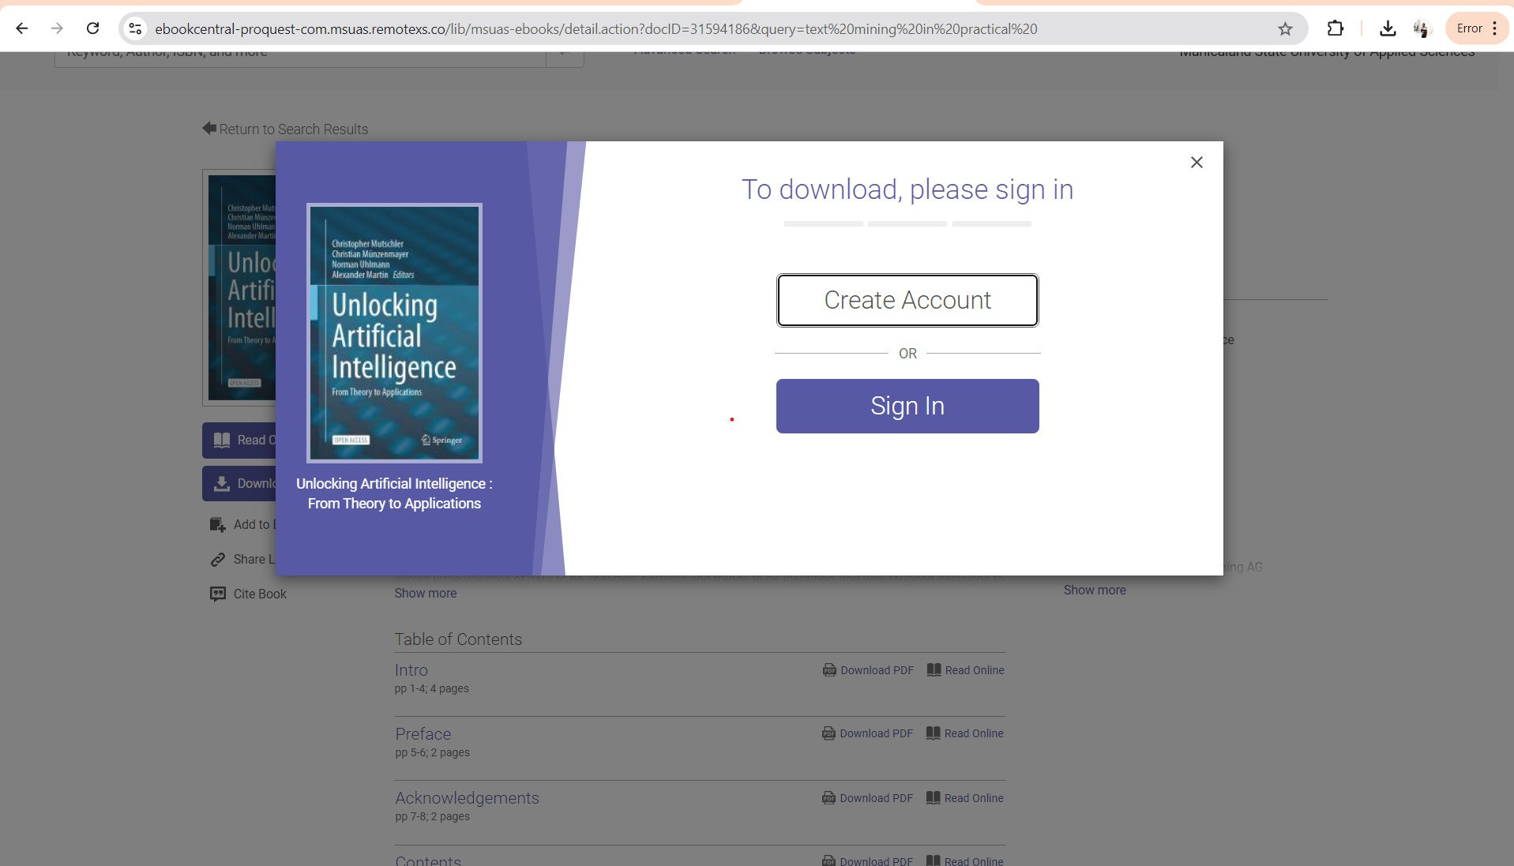
Step 11: Create an account or sign in

Slide 14
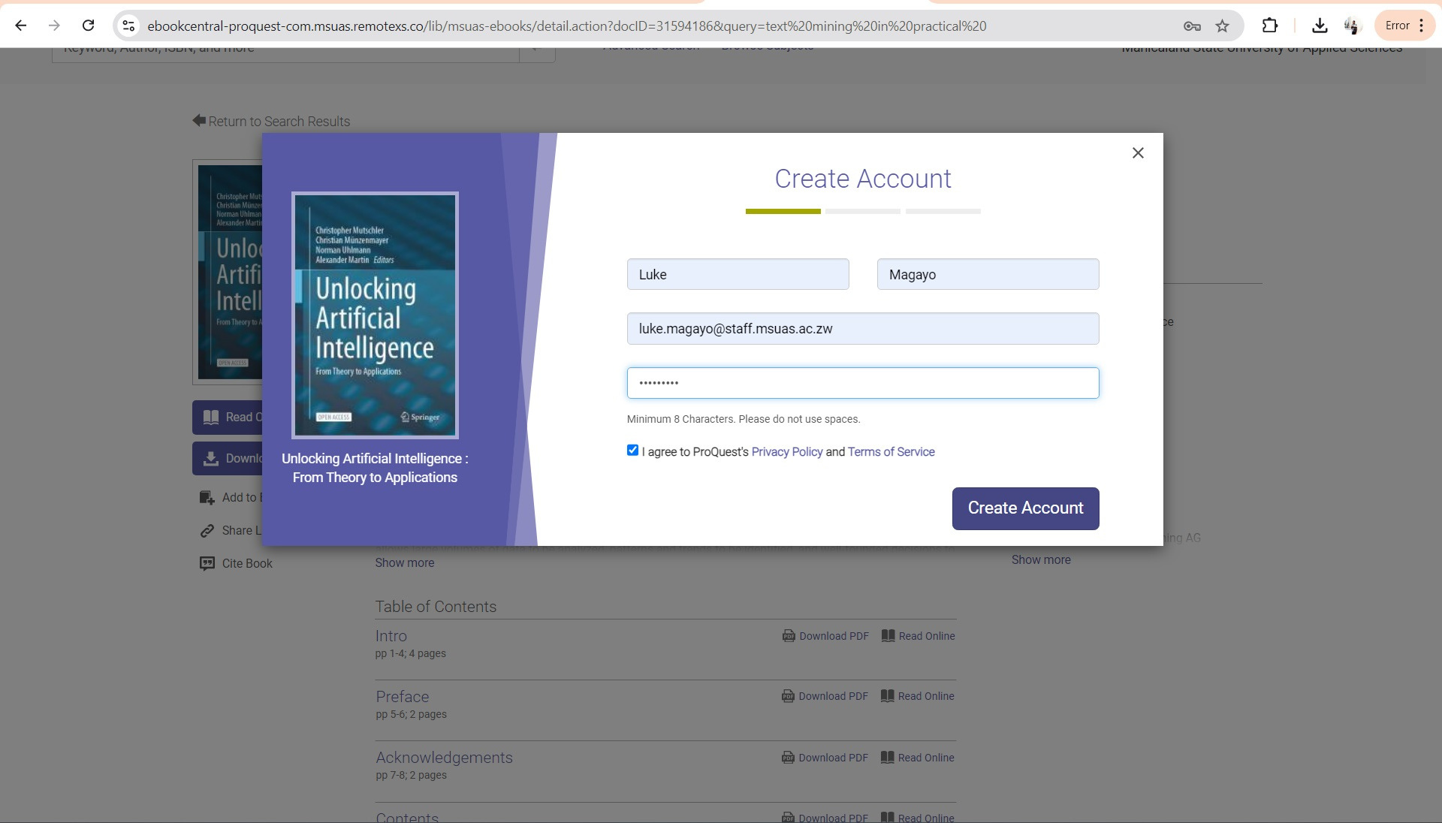
Step 12: Create an account or sign in

Slide 15
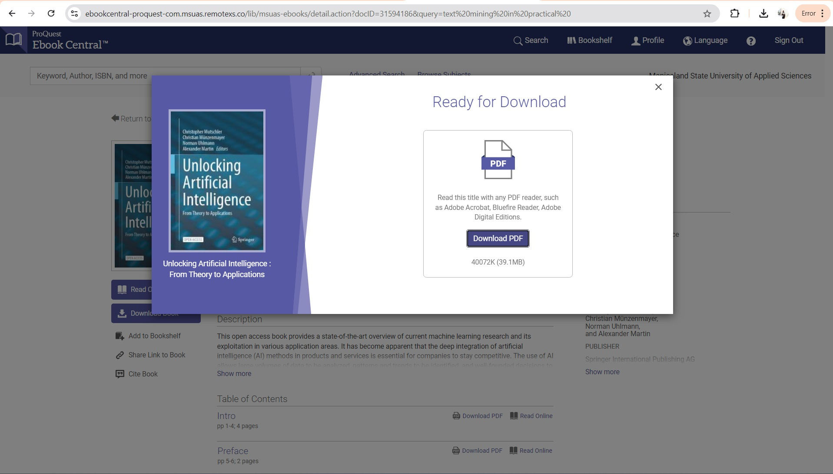
Step 12: Continue to download pdf

Slide 16
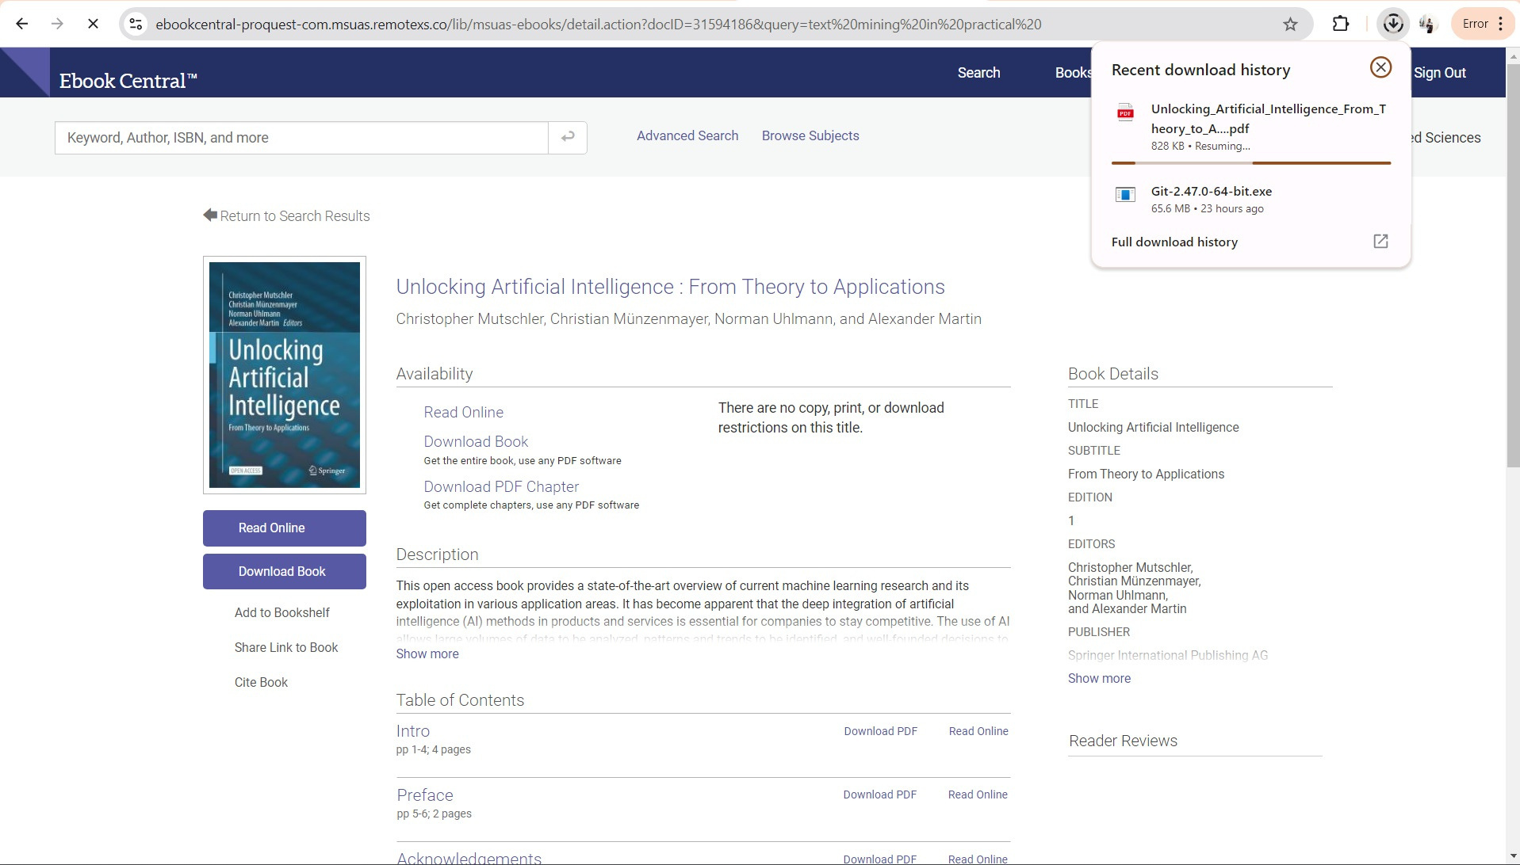
Step 13: Wait for download to finish

Slide 17
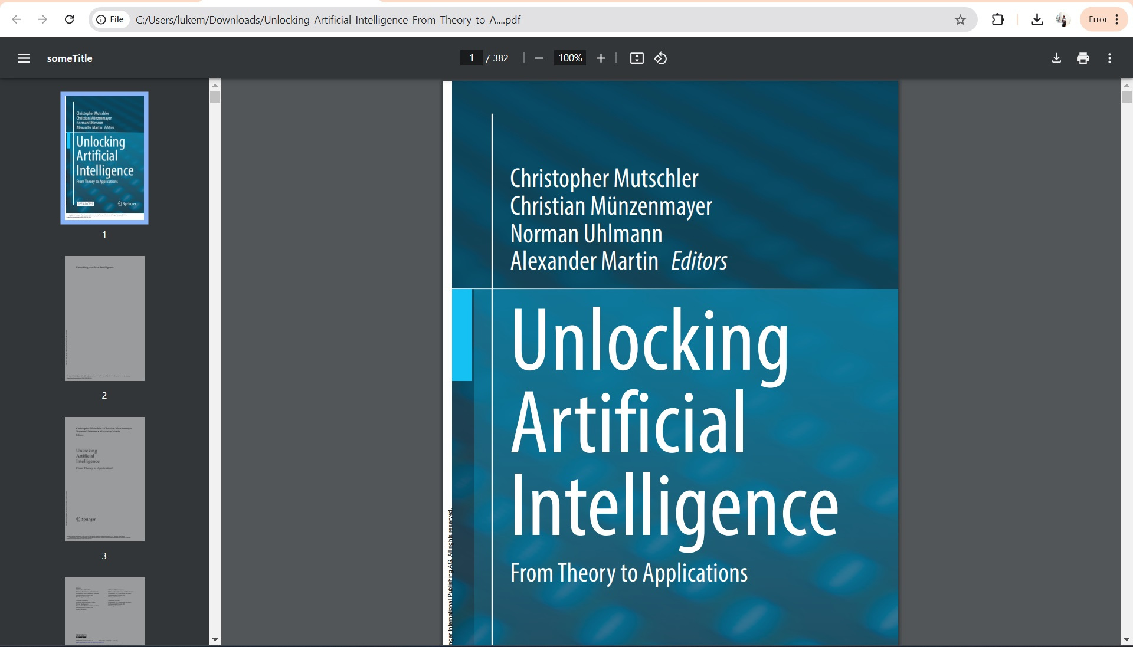
Step 14: Open & read your e-book

Slide 18
Community over Commercialization
October 21-27, 2024
#OAWeek

